Slide 1
Qualifications
for Data Analyst
in California
Aoran Zhang
Yi Meng
Xiaofei Li
University of California Davis

Slide 2


Motivation
1．
2．
3．

Slide 3
Project Procedure
1．
2．
3．
4．

Slide 4
Skills Requirements
Web
Scrapping
Basic
Requirements
Data source and cleaning

Slide 5
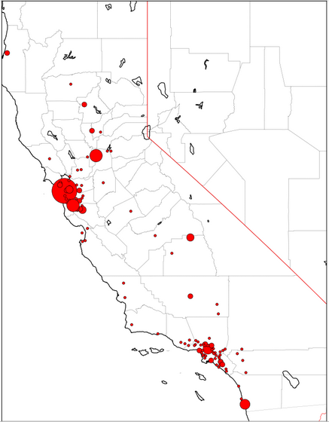
Skills Requirements
Web
Scrapping
Basic
Requirements
SAC
SF
PA
LA
SD

Slide 6
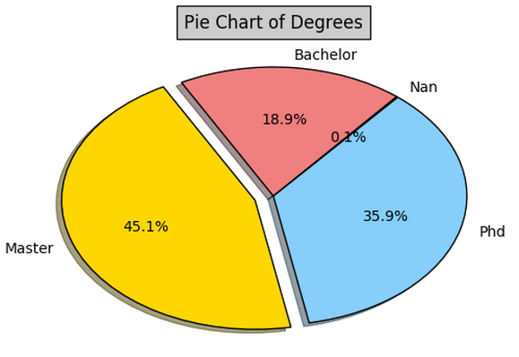
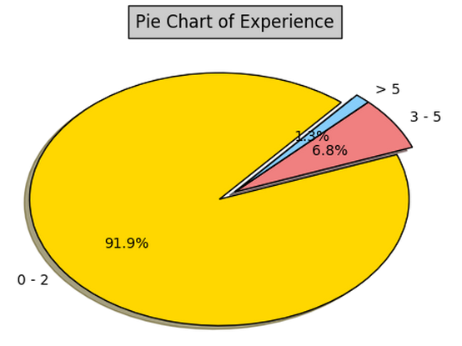
Skills Requirements
Web
Scrapping
Basic
Requirements
Pie Chart of Education Background
Pie Chart of Working Experience

Slide 7

Skills Requirements
Web
Scrapping
Basic
Requirements
Natural Language Processing
Stem
lemmatize
lDF Calculation

Slide 8
Skills Requirements
Web
Scrapping
Basic
Requirements
Word cloud

Slide 9
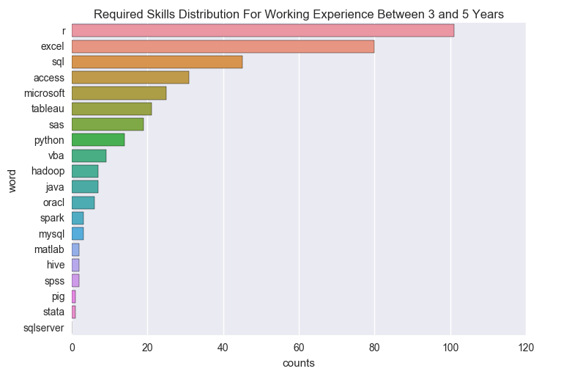
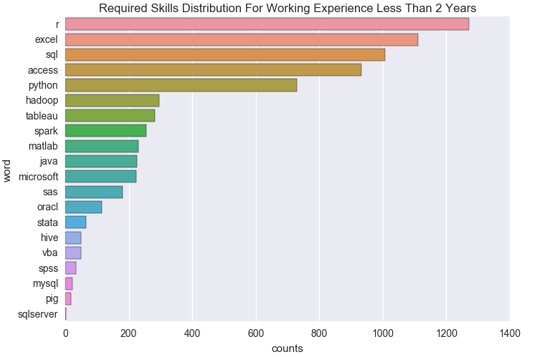
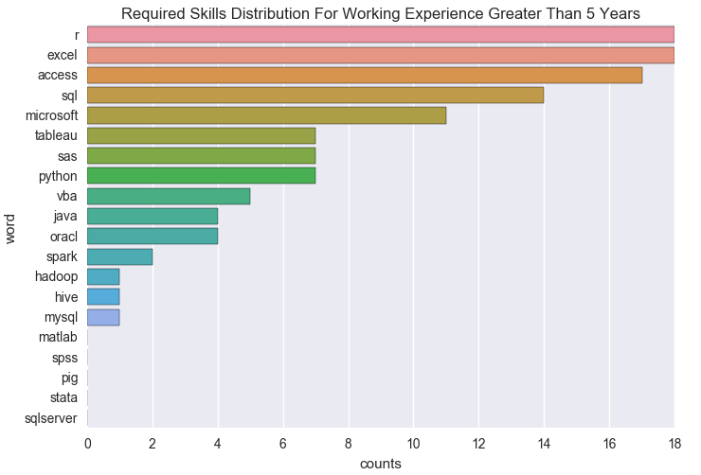
Skills Requirements vs Working Experience
Web
Scrapping

Slide 10
Skills Requirements vs Education Background
Web
Scrapping

Slide 11

Method
Generalization

Slide 12

Method Generalization
Guide the choice of employment place
Key factors to improve competitiveness
Generalize to analyze big data
城市收入水平，建设水平，行业发展前景对毕业生选择就业城市有一定影响

Slide 13
Aoran Zhang Yi Meng Xiaofei Li
Thank you!
University of California, Davis

